Slide 1
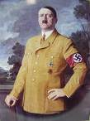
Adolf Hitler and the
Nazi Party

Slide 2
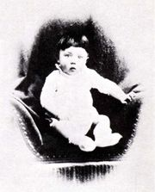
Hitler’s early life.
Born April 20th, 1889 in Braunau, Austria.
Unsuccessful school student.
Left home at 19 to be an artist in Vienna, Austria.
Rejected by the art academy, he lived in a hostel for tramps.
During his years in Vienna he became interested in nationalistic politics and developed a hatred for foreign races, especially Jews.

Slide 3
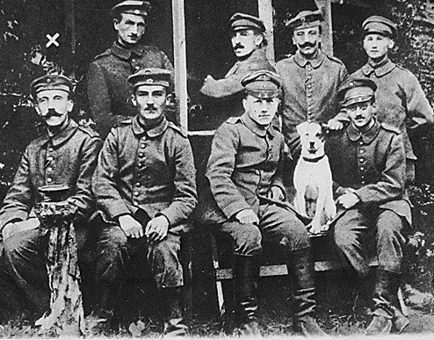
Hitler’s early life
Hitler left Austria for Germany in 1913 to avoid National Service.
He volunteered for the German army when World War One began.
Corporal Hitler was wounded twice in battle and received six medals for bravery, including the Iron Cross First Class.
Hitler stayed in the army after the war ended, working as a ‘V man’, spying on political parties to find out if they were dangerous.
One party was the German Workers Party, Hitler liked their ideas and joined their ranks in 1919/1920.

Slide 4
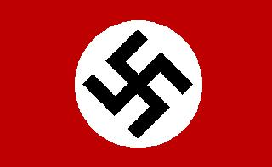
Hitler and the Party
Hitler became the undisputed leader of the party in 1920.
He renamed the party the National Socialist German Workers Party (The Nazi Party for short).
He made the swastika the symbol of the party.

Slide 5
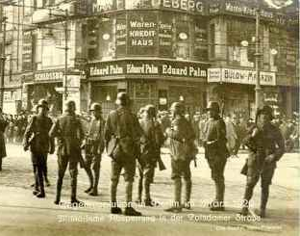
Hitler and the Party
He organised ‘Storm Troopers’ (SA) in brown uniforms to beat up political opponents.
In 1923 Hitler and his supporters tried to overthrow the government with their Munich Putsch.

Slide 6
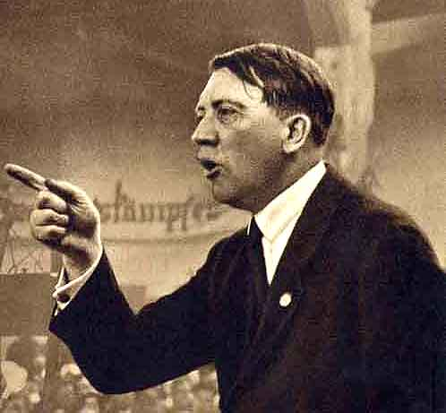
Hitler’s Appeal
He had a powerful, dominating personality.
Mesmerising public speaker.
He was intelligent and decisive.
Although he was a small man he has a great physical presence.

Slide 7
Hitler’s Ideas
Most of Hitler’s ideas can be found in his book Mein Kampf, which he wrote in prison in 1924.
The Fuhrer Principle: Germany must be ruled by a single, strong leader who has great power.
Lebensraum (living space): Germans need more land to live and work in. They will get this land be taking over the nations east of its border (for example Russia and Poland).
Race: Human beings are divided into races. The best races are ‘pure’ ones which have not interbred with others. The Germans who belonged to the ‘Aryan’ race must keep themselves pure in order to become the ‘master race’.

Slide 8
Hitler’s Ideas …..
Anti-Semitism: Jews, or Semites as Hitler called them are the biggest threat to the purity of the Germans. They are also involved in a great conspiracy to take control of the world. They helped to bring about Germany’s defeat in the Great War. Jews must therefore be destroyed.
Communism: Communism, the political system of Russia, is dangerous, so it too must be destroyed.
The Treaty of Versailles: The peace treaty which Germany signed in 1919 is unfair. It must be cancelled and the land which it took away from Germany must be returned. France must be destroyed.

Slide 9
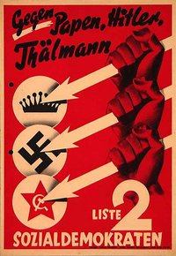
The Nazi Party
In February 1925, three months after coming out of prison, Hitler called his followers to a meeting. At the meeting he re-founded the Nazi Party, telling his followers;
“Instead of working to achieve power by an armed putsch, we shall have to ….. enter the Reichstag….”

Slide 10
What did the Nazi Party stand for in this phase ?
They needed to have attractive policies to win reichstag support and hence enter power legally…. This was Hitlers key aims post his imprisonment …

Slide 11

Destroy
Marxism
Destroy the
Weimar
Republic
Abolish
Treaty of
Versailles
Re-arm
Germany
Remove
Jews from
positions
of power
Conquer
Lebensraum
Nazi
Policies
Use
terror and
violence
Nationalize
important
industry
No
foreigners as
newspaper
editors
Strong
central
government
Government
education
for gifted
children
Increase old
age pensions

Slide 12
Growth of the Nazi Party
After re-founding the Nazi Party Hitler expanded the SA and set up a second military group, the black shirts (SS) in 1925.
He set up Party branches in all parts of the country, which in turn set up special organisations, such as the Hitler Youth, the German Girls League, the Nazi Students League, the Nazi Teachers League. All looking at increasing Nazi control and power.
By the end of 1928, 108, 717 Germans belonged to the party. It was growing in strength.

Slide 13
Growth of the Nazi Party
The failure of the Munich Putsch made Hitler realise that they could not take control of Germany by force and needed to act legally.
He therefore needed to take power by standing for elections for the Reichstag, holding rallies, putting out newspapers and leaflets, hence the contolling organisations, and ultimately winning support.
This could only be done if the Nazi Party was well organised with branches in all parts of the nation and was seen to be a successful alternative in power and had good policies to offer the people fed up with the Weimar Politicians in power. A strong, controlling leader was required at this time in Germany….. Hitler was the man.

